Slide 1
Ecphrastic poetry & the development of professional literacy in music

Slide 2
What is ecphrastic poetry?
Ecphrastic poetry is the conversation between two pieces of art. The writer interprets a work of visual art and then creates a narrative in verse form that represents his or her reaction to that painting, photograph, sculpture or other artistic creation.
http://www.firkinfiction.com/11.html

Slide 3
Ecphrastic poetry and music
How do you write a music-related poem in an ecphrastic manner?
Complete the following steps:
View a stimulus image and identify a music-related concept it evokes.
If required, write down the concept, definition, law, formula etc.
Identify a suitable poetry type and write the poem.

Slide 4
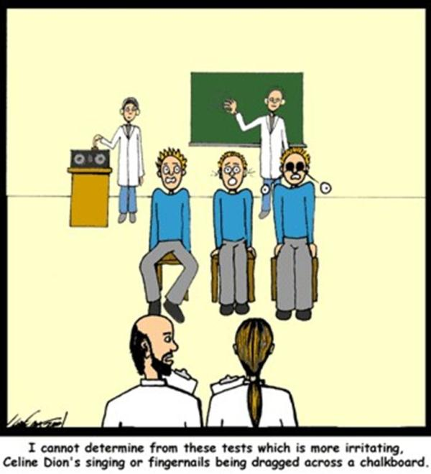
What concept does this image evoke?
http://www.citizenarcane.com/files/2005/May/25/cartoon.jpg

Slide 5
Intonation

Slide 6
Example Haiku poem
Bad intonation
Strings are sharp and reeds are flat
Brass, too loud again
http://www.violinist.com/discussion/response.cfm?ID=5332

Slide 7
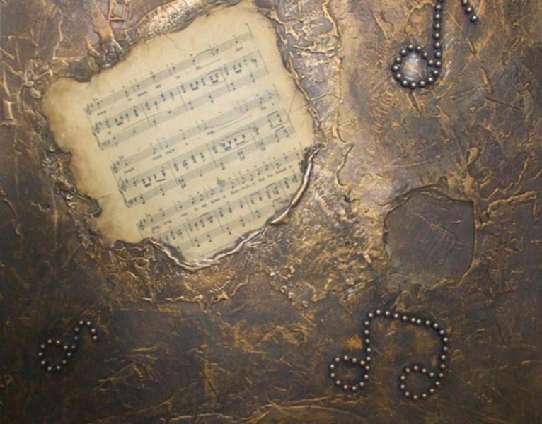
What concept does this image evoke?
http://contestedart.com/wp-content/uploads/2009/08/musical-magic.jpg

Slide 8
Musical terminology

Slide 9
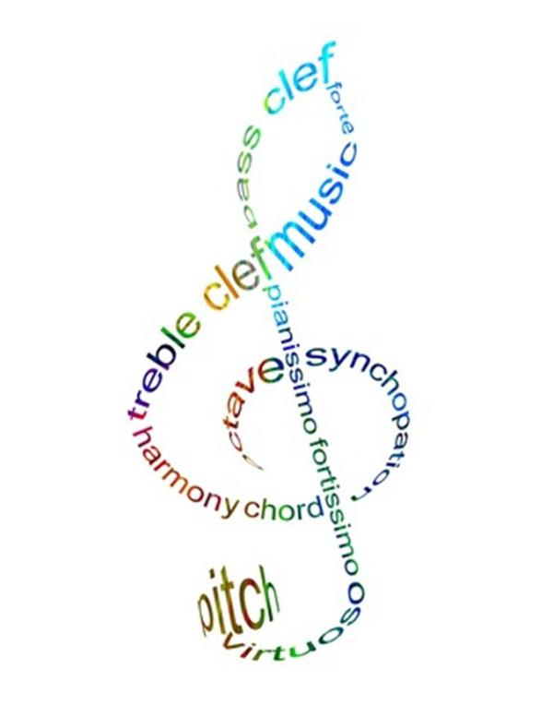
Example Concrete poem
http://theatricallyinvolved.files.wordpress.com/2010/03/treblepoemcopy.jpg

Slide 10
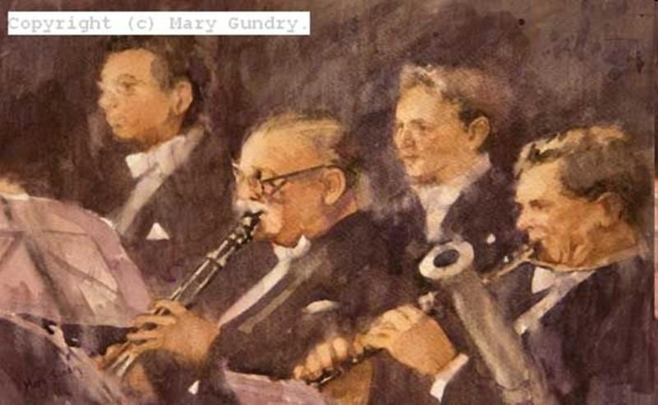
What concept does this image evoke?
http://marygundry.com/images/large/Woodwind%20Section.jpg

Slide 11
Beethoven

Slide 12
Example Acrostic poem
Born in Bonn in 1770
Established career in Vienna
Emperor piano concerto premiered in Vienna
Taught a few students music
Hearing loss suffered around 1796
Oral or written resposes to frineds
Violin concerto was written during the ‘Middle Period’
Eight Symphony caused apogee with contemporary music
Never’ve married amd died during a thunder storm
http://wiki.answers.com/Q/Can_you_make_an_acrostic_poem_about_photosynthesis

Slide 13
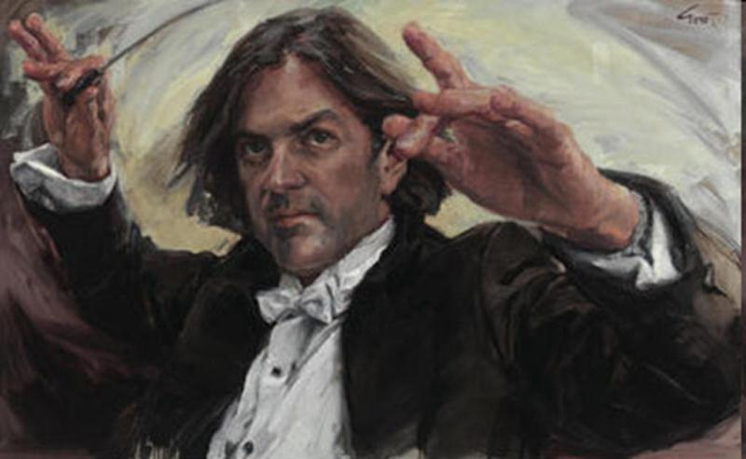
What concept does this image evoke?
http://www.theage.com.au/ffximage/2007/05/02/archy_peoples,2.jpg

Slide 14
An orchestral conducter

Slide 15
Example Limerick poem
The opera opened with flair, as the maestro wowed everyone there, no baton was flayed as the orchestra played, he led it by swinging his hair!
http://kingpoetry.com/limmusic.htm

Slide 16
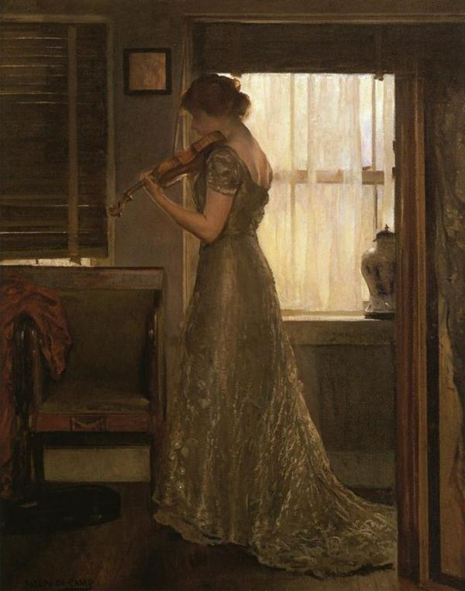
What concept does this image evoke?
http://www.paintinghere.com/UploadPic/Joseph%20DeCamp/big/The%20Violinist.jpg

Slide 17
The magic of music

Slide 18
Example Free Verse poem
Across the dimly lighted room
The violin drew wefts of sound,
Airily they wove and wound
And glimmered gold against the gloom.
I watched the music turn to light,
But at the pausing of the bow,
The web was broken and the glow
Was drowned within the wave of night.
http://www.poemhunter.com/poem/a-minuet-of-mozart-s/

Slide 19
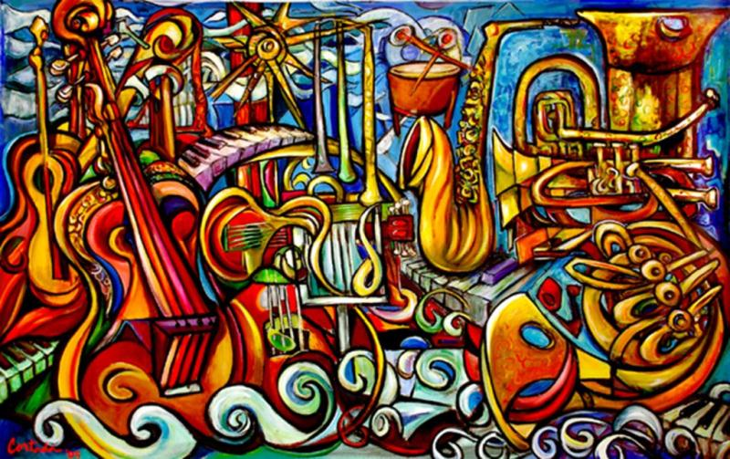
What concept does this image evoke?
http://www.cortada.com/gallery/paintings/2005/music.JPG

Slide 20
Types of musical instruments

Slide 21
Example Cinquain poem
Trumpets, throats stretching bout, cheeks bulging, muscle clout, puckered lips, blowing in and out, Music!
http://www.voicesnet.org/displayonepoem.aspx?poemid=140815

Slide 22
Example Cinquain poem
Guitars, strings vibratin’, blues, country, rockin’ scene, fingers, thumbs, pluckin’ and strummin’ Music!
http://www.voicesnet.org/displayonepoem.aspx?poemid=140815

Slide 23
Example Cinquain poem
Organs, tango, jazzy, make your choice, ranging free, sounds that blend simultaneously Music!
http://www.voicesnet.org/displayonepoem.aspx?poemid=140815

Slide 24
Example Cinquain poem
Cymbals, slide, scrape, clash, crash, up and down, rhythmic hands, thin, steely round plates, swishing bands, Music!
http://www.voicesnet.org/displayonepoem.aspx?poemid=140815

Slide 25
Example Cinquain poem
Pianos, strings strike keyboards, hammers hit diverse chords, incredible pitch echoes loud, Music!
http://www.voicesnet.org/displayonepoem.aspx?poemid=140815

Slide 26
Example Cinquain poem
Bugles, keys few, pitch small, taps - announcing death toll, military dawn wake-up call, Music!
http://www.voicesnet.org/displayonepoem.aspx?poemid=140815

Slide 27
Activity
Using the given stimulus material, create the following types of poetry:
Free verse
Acrostic
Cinquain
Haiku
Limerick

Slide 28
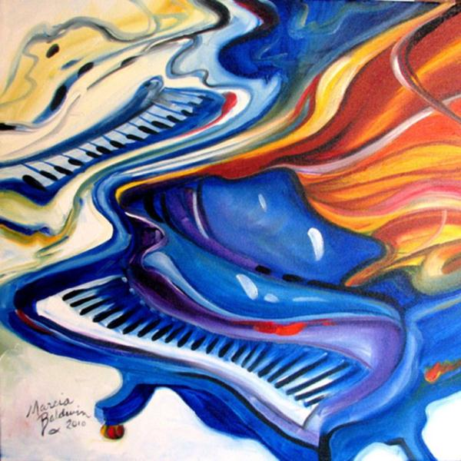
STIMULUS IMAGE 1
http://marciabaldwin.artspan.com/show-image/1037366/Marcia-Baldwin/
JAZZ-PIANOS-GRAND-16x16-ORIGINAL-OIL-PAINTING-ABSTRACT-MUSIC-SERIES-by-M-BALDWIN.jpg

Slide 29
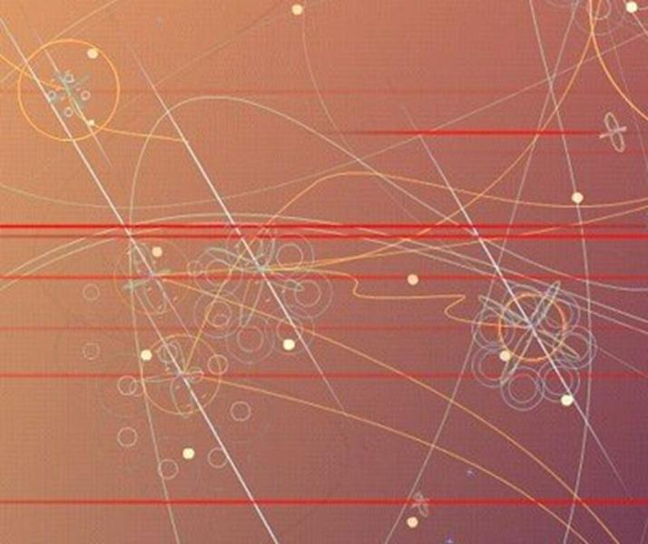
STIMULUS IMAGE 2
http://ursispaltenstein.ch/blog/images/uploads_img/visual_acoustics_.jpg

Slide 30
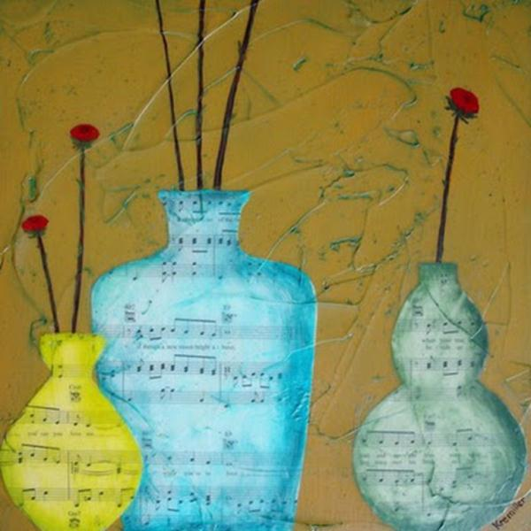
STIMULUS IMAGE 3
http://2.bp.blogspot.com/_jWTi8RTSXfk/R698k3XtFUI/AAAAAAAAASk/aAtjqHkltms/s400/three+vases+painting.jpg

Slide 31
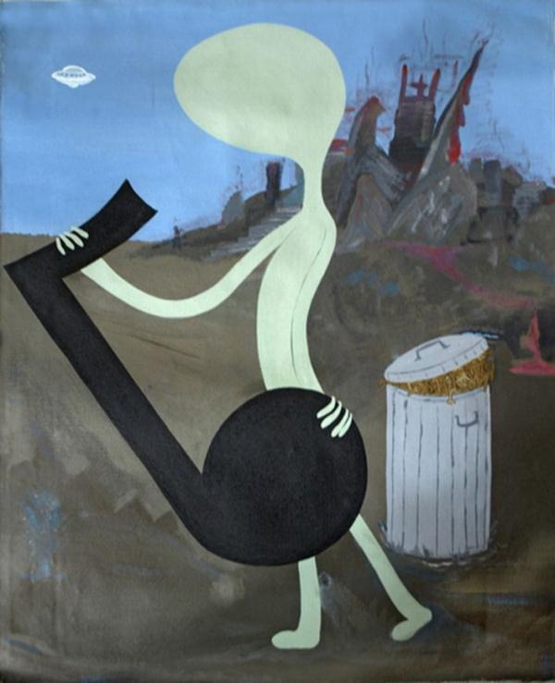
STIMULUS IMAGE 4
http://www.well.com/~hendrix/paintings/AlienMusicPainting.jpg

Slide 32
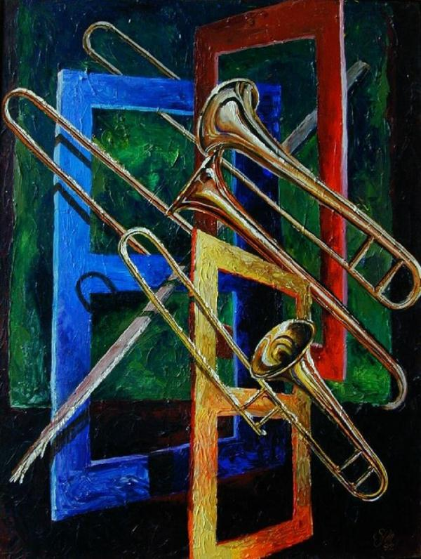
STIMULUS IMAGE 5
http://tromboneforum.org/gallery/7478_09_07_07_1_20_47.jpg

